Slide 1
Dimensionality Reduction

Slide 2
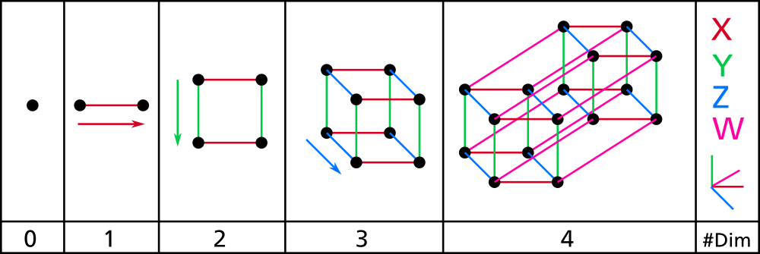
Curse of Dimensionality
Notes:
4: translation over time…

Slide 3

Curse of Dimensionality
One dimension:
Small space
Being close quite probable
Cigarettes per day

Slide 4

Curse of Dimensionality
Two dimensions
Height
Cigarettesper day

Slide 5
Curse of Dimensionality
Two dimensions:
More space but still not so much Being close not improbable
Height
Cigarettes per day

Slide 6

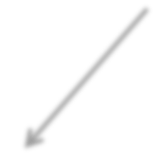

Curse of Dimensionality
Height
Three dimensions
Cigarettes per day
Income

Slide 7
Curse of Dimensionality
Height
Three dimensions:
Much larger space Being close less probable
Cigarettes per day
Income

Slide 8
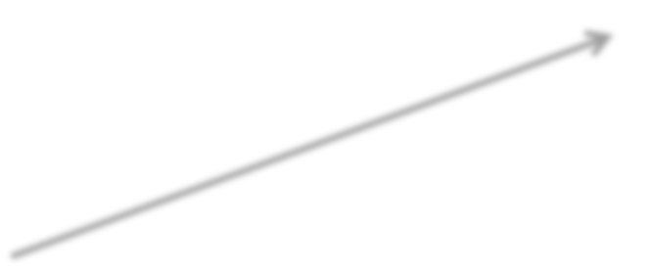
Curse of Dimensionality
Height
Age
Four dimensions
Cigarettes per day
Income

Slide 9
Curse of Dimensionality
Height
Age
Four dimensions:
omg so much space
Being close quite improbable
Cigarettes per day
Income

Slide 10

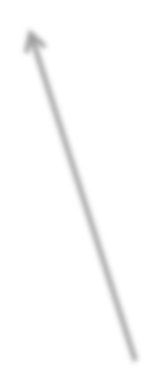
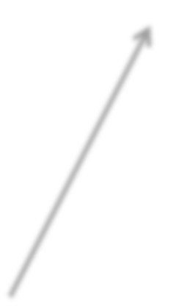
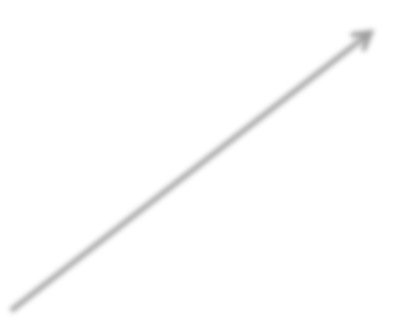
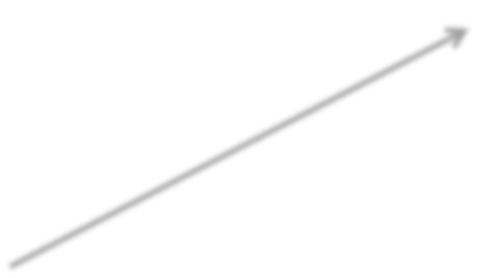
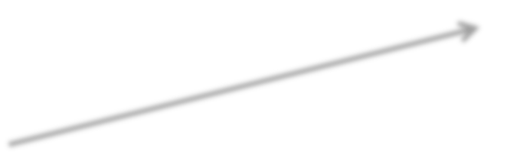

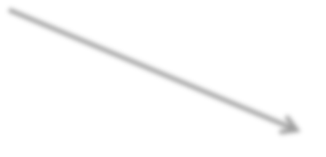


Curse of Dimensionality
Thousand dimensions: Helloooo… hellooo.. helloo… Can anybody hear meee.. mee.. mee.. mee..
So alone….

Slide 11
Curse of Dimensionality
Thousand dimensions:
I speciﬁed you with such high resolution, with so much detail, that you don’t look like anybody
else anymore. You’re unique.

Slide 12
Curse of Dimensionality
Demonstration of how space grows
(ipython notebook)

Slide 13

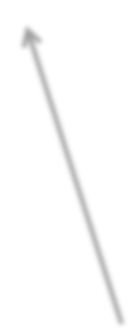


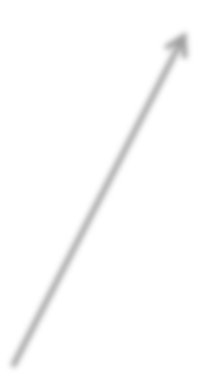
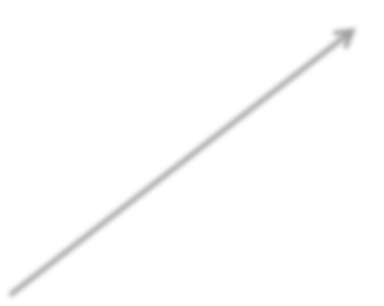
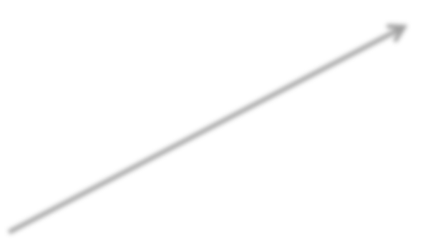
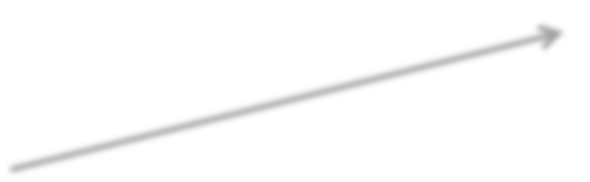


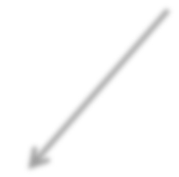
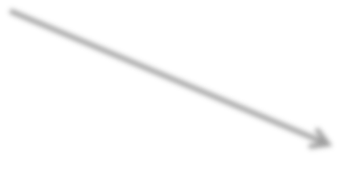



Curse of Dimensionality
Classification, clustering and other analysis methods become exponentially diﬃcult with increasing dimensions.
Height
Cigarettes per day

Slide 14
Curse of Dimensionality
Classification, clustering and other analysis methods become exponentially diﬃcult with increasing dimensions.
To understand how to divide that huge space, we need a whole lot more data (usually much more than we do or can have).
Height
Cigarettes per day

Slide 15
Dimensionality Reduction
Lots of features, lots of data is best. But what if you don’t have the luxury of ginormous amounts of data?
Not all features provide the same amount of information. We can reduce the dimensions (compress the data)
without necessarily losing too much information.
Height
Cigarettes per day

Slide 16


Feature Selection
Height
Cigarettes per day

Slide 17
Feature Selection
Healthy / Heart Disease
Height
Cigarettes per day

Slide 18
Feature Selection
Healthy / Heart Disease
Height
Cigarettes per day

Slide 19
Feature Selection
Healthy / Heart Disease
Height
Cigarettes per day

Slide 20
Feature Selection
Healthy / Heart Disease
Height
Cigarettes per day

Slide 21
Feature Selection
Healthy / Heart Disease
Cigarettes per day

Slide 22
Feature Selection
Healthy / Heart Disease
Cigarettes per day

Slide 23
Feature Selection
Healthy / Heart Disease
Cigarettes per day

Slide 24
Feature Selection
Healthy / Heart Disease
Cigarettes per day

Slide 25
Feature Selection
Healthy / Heart Disease
Cigarettes per day

Slide 26

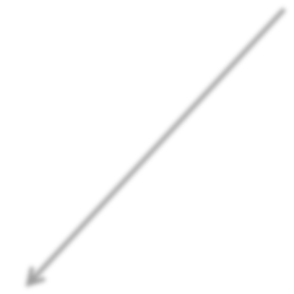

Feature Selection
Metascore
Box Oﬃce Gross
Size of cast

Slide 27

Feature Selection
Metascore
Box Oﬃce Gross
Size of cast

Slide 28
Feature Selection
Metascore
Box Oﬃce Gross
Size of cast

Slide 29
Feature Selection
Metascore
Box Oﬃce Gross

Slide 30
Feature Selection
Common Sense
Experiments (remove a feature, ﬁt again, evaluate results)
Regularization (in regression)
Feature scores (chi², F-­‐test, etc. : SelectKBest())

Slide 31


Feature Extraction
Do I have to choose the dimensions among existing features?
Metacritic
Score
Awards won

Slide 32

Feature Extraction
Do I have to choose the dimensions among existing features?
Metacritic
Score
Awards won

Slide 33

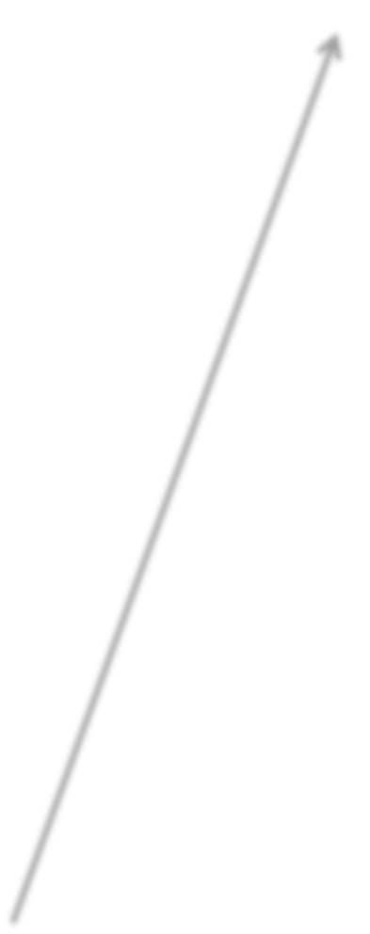
Feature Extraction
Metacritic
Score
0.7 (Metacritic Score) + 0.3 (Awards Won)
Awards won

Slide 34
Feature Extraction
Metacritic
Score
0.7 (Metacritic Score) + 0.3 (Awards Won)
Awards won

Slide 35
Feature Extraction
Metacritic
Score
0.7 (Metacritic Score) + 0.3 (Awards Won)
Awards won

Slide 36
Feature Extraction
Metacritic
Score
Awards won

Slide 37
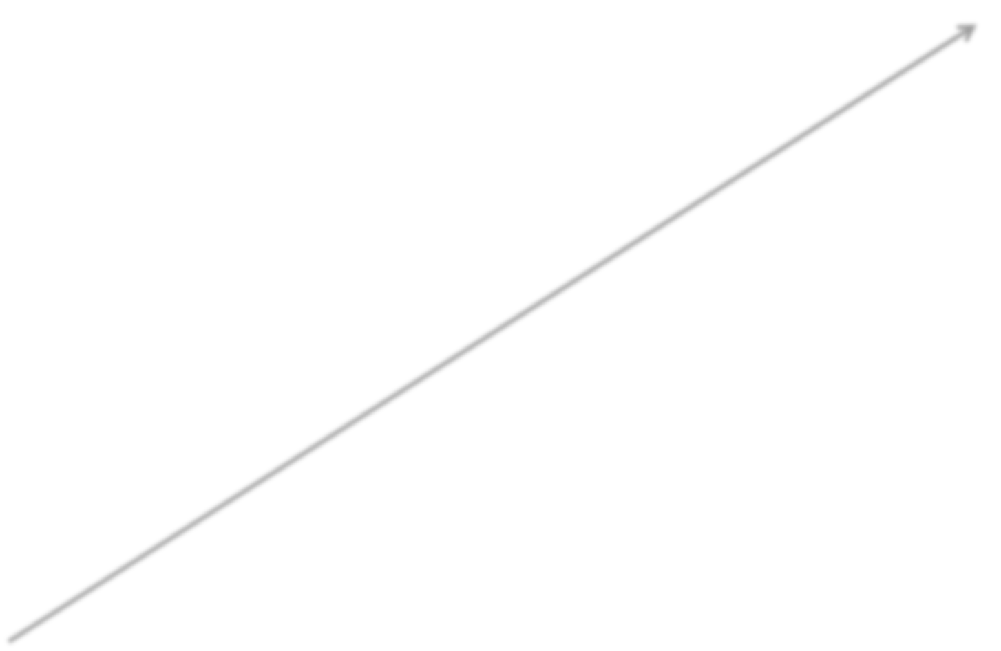
Feature Extraction
0.398 (Metacritic Score) + 0.602 (Awards Won)
Metacritic
Score
Awards won

Slide 38
Feature Extraction
0.398 (Metacritic Score) + 0.602 (Awards Won)
Metacritic
Score
Awards won

Slide 39
Feature Extraction (PCA)
0.398 (Metacritic Score) + 0.602 (Awards Won)
Optimum!
Metacritic
Score
Awards won

Slide 40
Feature Extraction
Advantage: You retain more information
Disadvantage: You lose interpretability

Slide 41
Feature Extraction
Advantage: You retain more information
Disadvantage: You lose interpretability
2D
Oscar_or_not = logit( β₁(Metascore) + β₂(Awards) )

Slide 42
Feature Extraction
Advantage: You retain more information
Disadvantage: You lose interpretability
2D
Oscar_or_not = logit( β₁(Metascore) + β₂(Awards) )
Feature selection 1D
Oscar_or_not = logit( β₁(Metascore) )

Slide 43
Feature Extraction
Advantage: You retain more information
Disadvantage: You lose interpretability
2D
Oscar_or_not = logit( β₁(Metascore) + β₂(Awards) )
Feature selection 1D
Oscar_or_not = logit( β₁(Metascore) )
Feature extraction 1D
Oscar_or_not = logit( β₁(0.4*Metascore + 0.6*Awards) )

Slide 44
3D → 2D Feature Selection
Metascore
Box Oﬃce Gross
Size of cast

Slide 45

3D → 2D Feature Selection
Metascore
Box Oﬃce Gross
Size of cast

Slide 46
3D → 2D Feature Selection
Metascore
Box Oﬃce Gross
Size of cast

Slide 47
3D → 2D Feature Extraction (PCA)
Metascore
Box Oﬃce Gross
Size of cast

Slide 48
3D → 2D Feature Extraction (PCA)
Optimum plane
Metascore
Box Oﬃce Gross
Size of cast

Slide 49




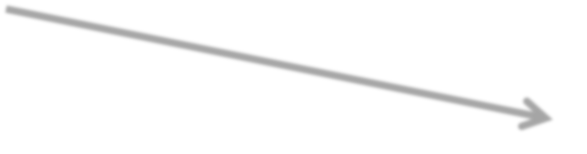
3D → 2D Feature Extraction (PCA)
Optimum plane
Metascore
A₁ *(Metascore) + B₁ *(Gross) + C₁ *(Cast)
Box Oﬃce Gross
A₂ *(Metascore) + B₂ *(Gross) + C₂ *(Cast)
Size of cast

Slide 50
3D → 2D Feature Extraction (PCA)
Optimum plane
Metascore
A₁ *(Metascore) + B₁ *(Gross) + C₁ *(Cast)
Box Oﬃce Gross
A₂ *(Metascore) + B₂ *(Gross) + C₂ *(Cast)
Size of cast

Slide 51
from sklearn.decomposition import PCA
reducer = PCA( n_components = 20 )
reduced_X = reducer.ﬁt_transform(X)

Slide 52
How and why to use PCA
Improving your clustering
Improving your classification
(alternative to feature selection)
Visualizing high dimensional data in 2D or 3D
Data compression with little loss

Slide 53
PCA Math
Vectors deﬁning the reduced hyperplane are eigenvectors of the covariance matrix of the features.
Singular Value Decomposition (SVD) is a related decomposition that can be used to solve the PCA problem as well, and with better numeric properties.
(See notebook.)

